Slide 1

Machine Learning

Slide 2
Machine Learning
What is Machine Learning?

Slide 3
Machine Learning
Machine learning (ML) is the study of computer algorithms that can improve automatically through experience and by the use of data.
ML algorithms build a model based on sample data, known as training data, in order to make predictions without being programmed to do so.
ML algorithms are used in a wide variety of applications, such as in medicine, email filtering, speech recognition, and computer vision.

Slide 4
Machine Learning
Why Machine Learning?

Slide 5
Machine Learning
Machine Learning
vs
Traditional Programming

Slide 6

Traditional Programming
Data
Output
Rules
Computer

Slide 7
Machine Learning
Data
Rules
Output
Computer

Slide 8
Machine Learning
Types of Machine Learning

Slide 9
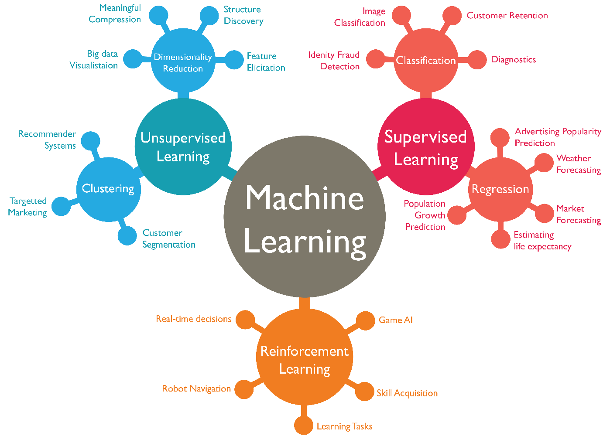

Slide 10
Supervised vs Unsupervised

Slide 11
Supervised Learning
Data
Rules
Output
Computer

Slide 12
Unsupervised Learning
Data
Rules
Computer

Slide 13
Regression Models

Slide 14
Regression Models
But what is a Model?

Slide 15
Regression Models
Model: is a parametric mathematical representation of a specific task.
Model: A computer program is said to learn from experience (E) with respect to some class of tasks (T) and performance measure (P) if its performance at tasks in (T), as measured by (P), improves with experience (E). (Tom Mitchel)

Slide 16
Linear Regression

Slide 17
Linear Regression
Price | Size
100,000 | 100
200,000 | 200
400,000 | 400
If a house have a size of 300 $m^{2}$, what would be it’s price?

Slide 18
Linear Regression
Price | Size
100,000 | 100
200,000 | 200
400,000 | 400
If a house have a size of 300 $m^{2}$, what would be it’s price?
Price = 300,000

Slide 19

Linear Regression
Price | Size
100,000 | 100
200,000 | 200
400,000 | 400
$$Price = 1000 ∗ Size$$

Slide 20
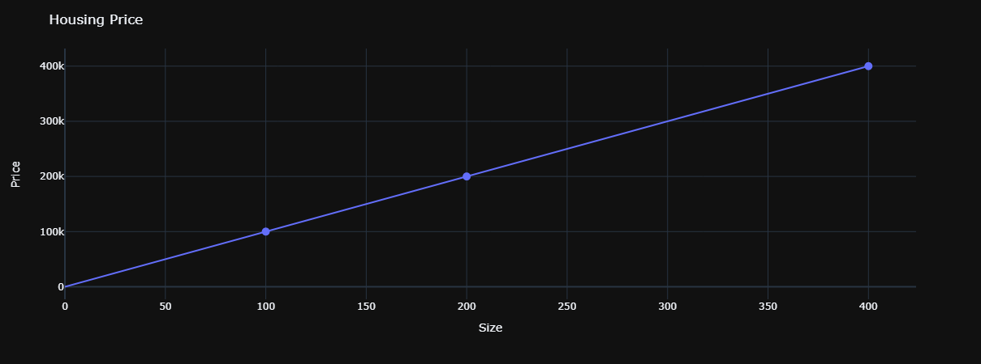
Linear Regression

Slide 21
Linear Regression
Price | Size
150,000 | 100
250,000 | 200
450,000 | 400
If a house have a size of 300 $m^{2}$, what would be it’s price?

Slide 22
Linear Regression
Price | Size
150,000 | 100
250,000 | 200
450,000 | 400
If a house have a size of 300 $m^{2}$, what would be it’s price?
Price = 350,000

Slide 23
Linear Regression
Price | Size
150,000 | 100
250,000 | 200
450,000 | 400
$$Price = 1000 ∗ Size+50,000$$

Slide 24
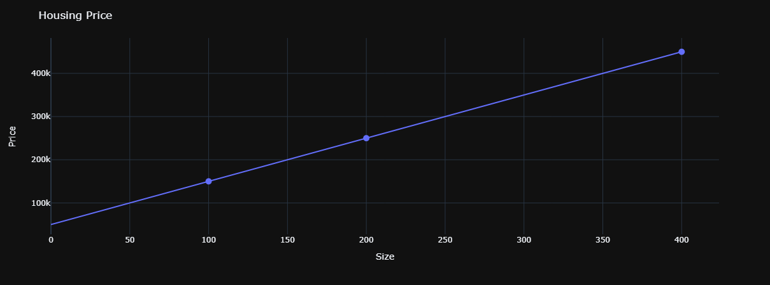
Linear Regression

Slide 25
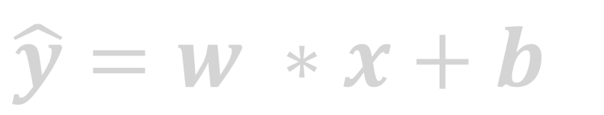
Linear Regression
The Output
Some weight
$$\hat{y}=w ∗x+b$$
Some Bias
The Input

Slide 26
Linear Regression
$$\hat{y}=w_{1}∗x_{1}+w_{2}∗x_{2}+…+w_{n}∗x_{n}+b$$

Slide 27
Linear Regression
$$\hat{y}=w⋅x+b$$

Slide 28
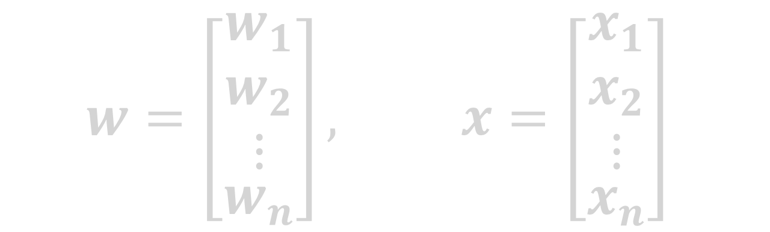
Linear Regression
$$\hat{y}=w⋅x+b$$
$$w=\left[\begin{aligned}\begin{matrix}w_{1} \\ w_{2} \\ ⋮\end{matrix} \\ w_{n}\end{aligned}\right], x=\left[\begin{aligned}\begin{matrix}x_{1} \\ x_{2} \\ ⋮\end{matrix} \\ x_{n}\end{aligned}\right]$$

Slide 29

Linear Regression
$$\hat{y}=w⋅x+b$$
$$w=\left[\begin{aligned}\begin{matrix}w_{1} \\ w_{2} \\ ⋮\end{matrix} \\ w_{n}\end{aligned}\right], x=\left[\begin{aligned}\begin{matrix}x_{1} \\ x_{2} \\ ⋮\end{matrix} \\ x_{n}\end{aligned}\right]$$
np.dot(w, x)

Slide 30
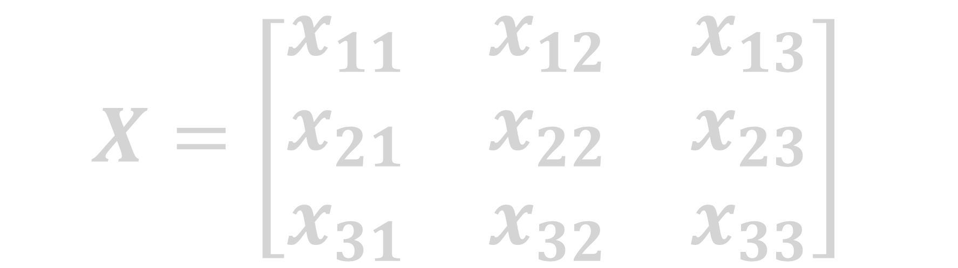
Linear Regression
$$X=\left[\begin{matrix}x_{11} & x_{12} & x_{13} \\ x_{21} & x_{22} & x_{23} \\ x_{31} & x_{32} & x_{33}\end{matrix}\right]$$

Slide 31
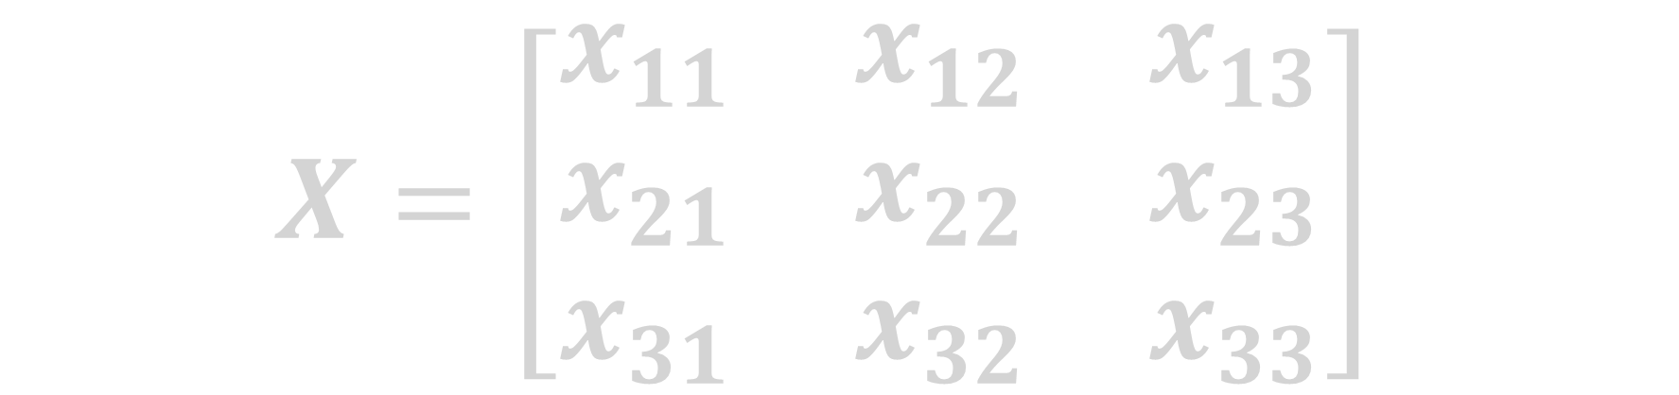
Linear Regression
$$X=\left[\begin{matrix}x_{11} & x_{12} & x_{13} \\ x_{21} & x_{22} & x_{23} \\ x_{31} & x_{32} & x_{33}\end{matrix}\right]$$
Python command>> X.T

Slide 32
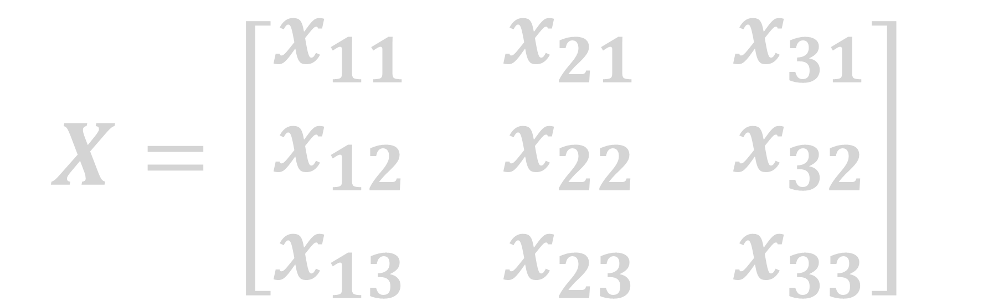
Linear Regression
$$X=\left[\begin{matrix}x_{11} & x_{21} & x_{31} \\ x_{12} & x_{22} & x_{32} \\ x_{13} & x_{23} & x_{33}\end{matrix}\right]$$

Slide 33
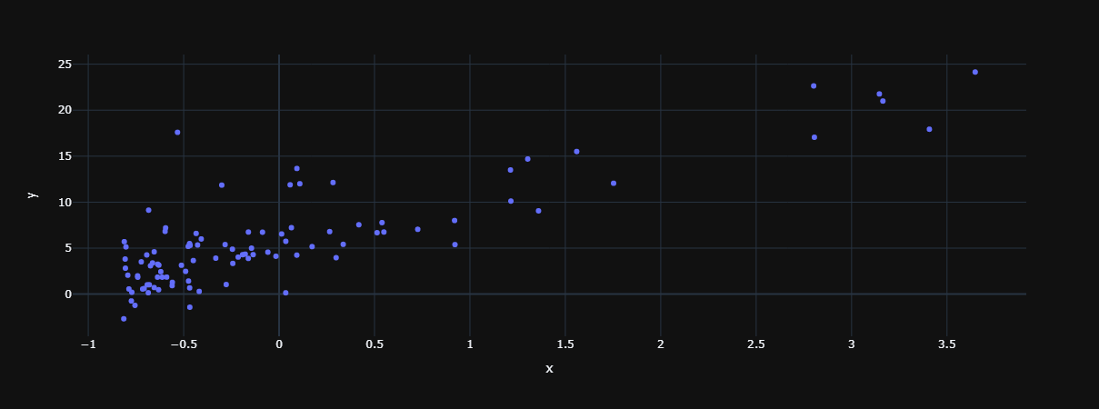
Linear Regression

Slide 34
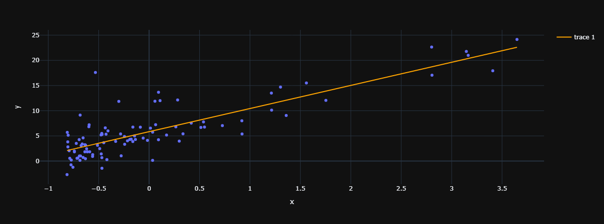
Linear Regression

Slide 35
Cost Function

Slide 36
Cost Function
What is Cost Function?

Slide 37
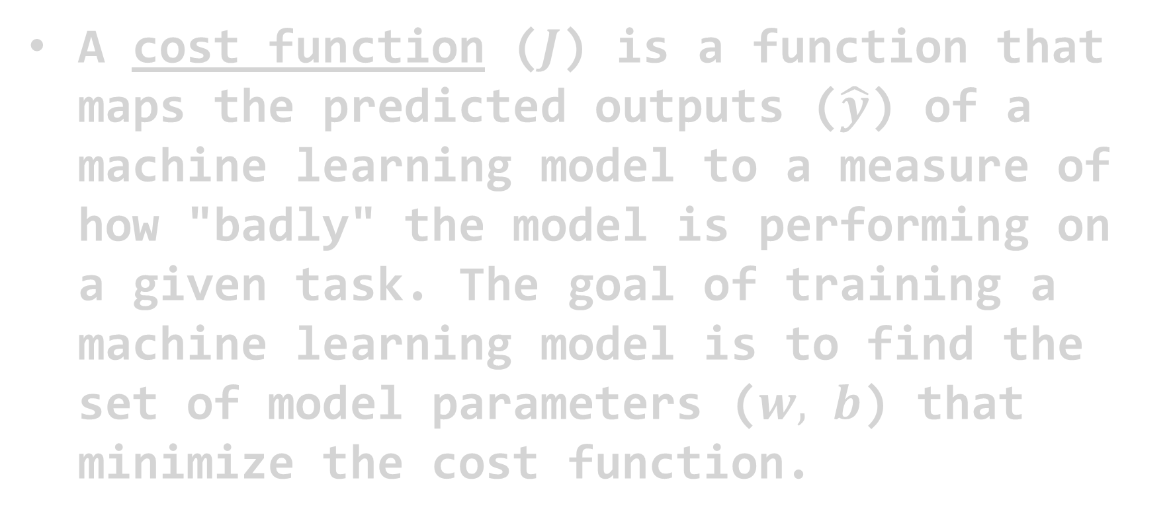
Cost Function
A cost function ($J$) is a function that maps the predicted outputs ($\hat{y}$) of a machine learning model to a measure of how "badly" the model is performing on a given task. The goal of training a machine learning model is to find the set of model parameters ($w, b$) that minimize the cost function.

Slide 38

Cost Function
$${\hat{y}}_{i}=w⋅x_{i}+b$$

Slide 39

Cost Function
$${\hat{y}}_{i}=w⋅x_{i}+b$$
$${\hat{y}}_{i}−y_{i}$$
The error

Slide 40

Cost Function
$${\hat{y}}_{i}=w⋅x_{i}+b$$
$${{(\hat{y}}_{i}−y_{i})}^{2}$$
The error squared

Slide 41

Cost Function
$${\hat{y}}_{i}=w⋅x_{i}+b$$
$$\frac{{{(\hat{y}}_{i}−y_{i})}^{2}}{2}$$

Slide 42
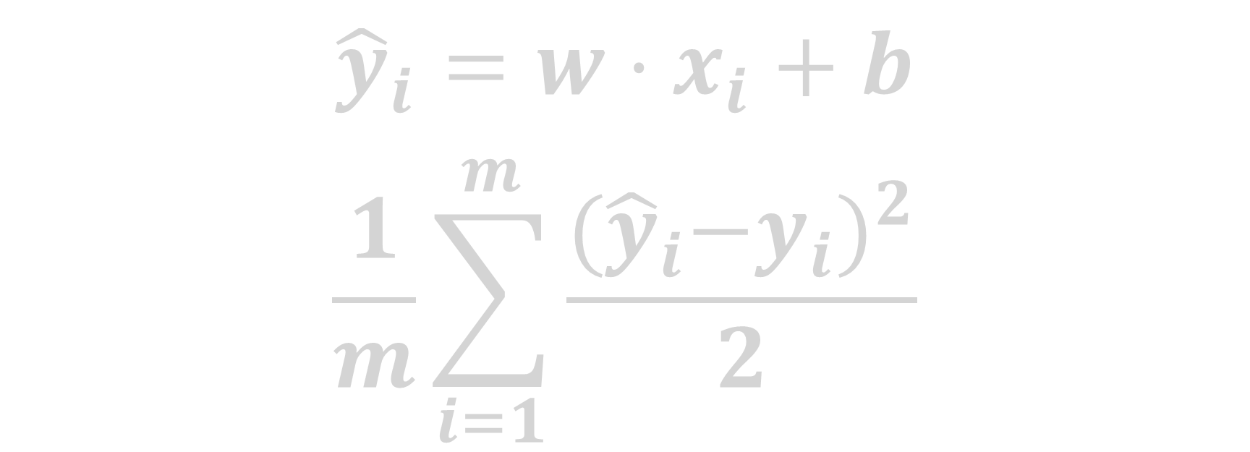
Cost Function
$${\hat{y}}_{i}=w⋅x_{i}+b$$
$$\frac{1}{m}\sum_{i=1}^{m}{\frac{{{(\hat{y}}_{i}−y_{i})}^{2}}{2}}$$
Taking the mean
Number of training examples

Slide 43
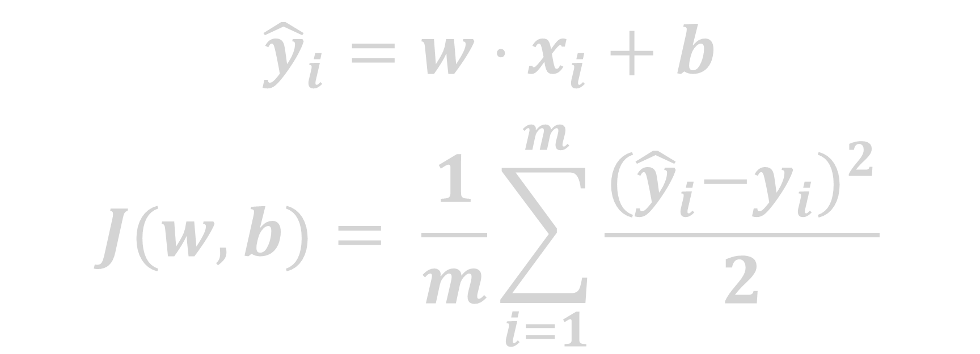
Cost Function
$${\hat{y}}_{i}=w⋅x_{i}+b$$
$$J(w, b)= \frac{1}{m}\sum_{i=1}^{m}{\frac{{{(\hat{y}}_{i}−y_{i})}^{2}}{2}}$$
This Cost Function is known as Mean Squared Error(MSE)

Slide 44
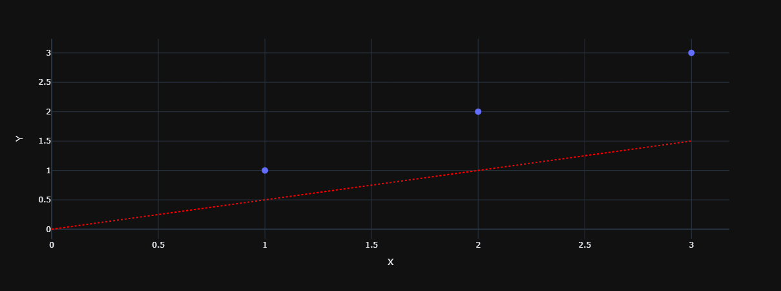



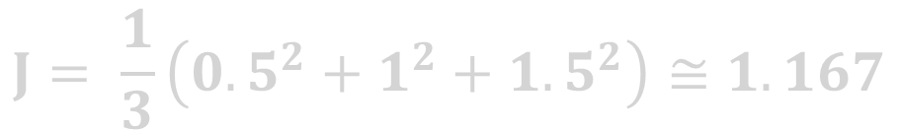
Cost Function
$$1.5$$
$$1$$
$$0.5$$
$$J= \frac{1}{3}\left({0.5}^{2}+1^{2}+{1.5}^{2}\right)≅1.167$$

Slide 45
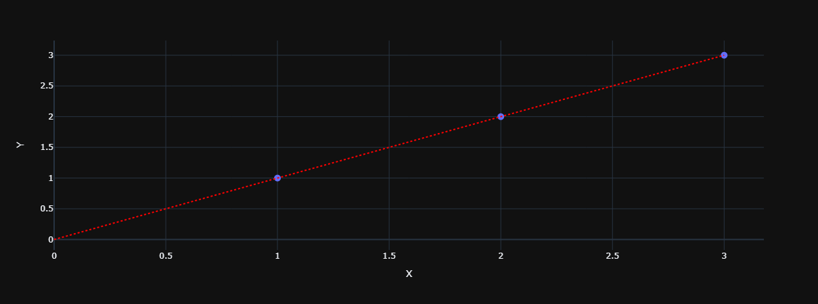
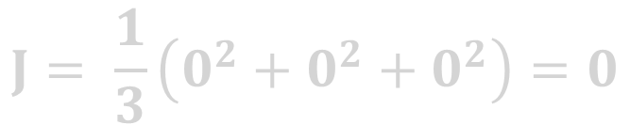
Cost Function
$$J= \frac{1}{3}\left(0^{2}+0^{2}+0^{2}\right)=0$$

Slide 46
Gradient Descent

Slide 47
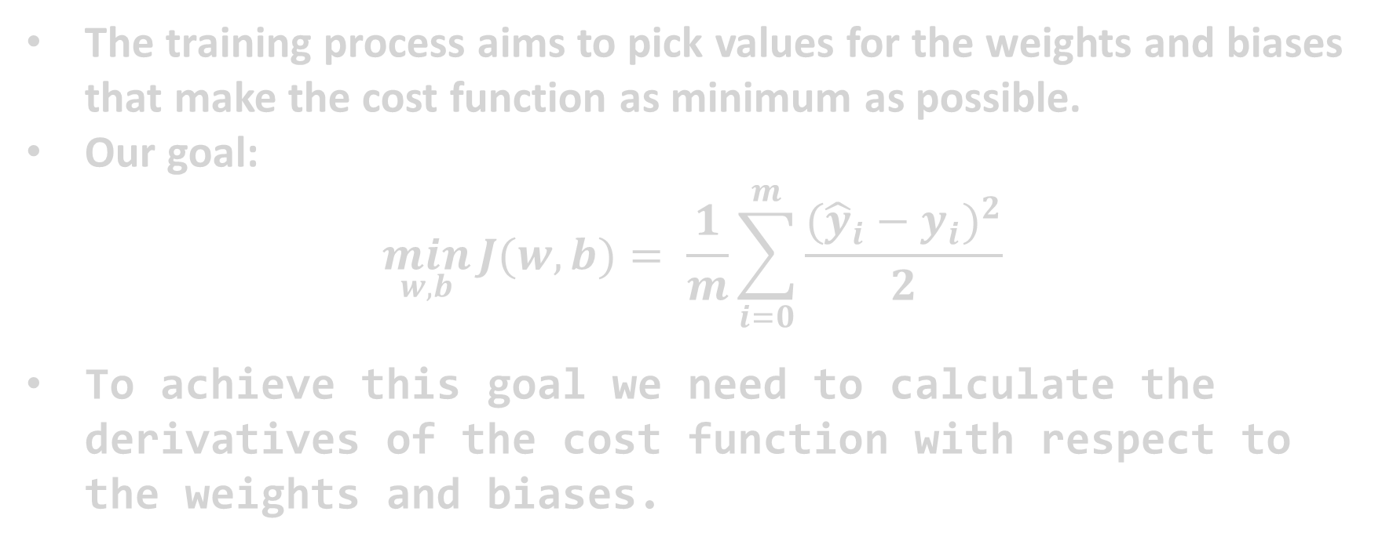
Gradient Descent
The training process aims to pick values for the weights and biases that make the cost function as minimum as possible.
Our goal:
$$\min_{w, b}{J(w, b)= \frac{1}{m}\sum_{i=0}^{m}{\frac{{({\hat{y}}_{i}−y_{i})}^{2}}{2}}}$$
To achieve this goal we need to calculate the derivatives of the cost function with respect to the weights and biases.

Slide 48
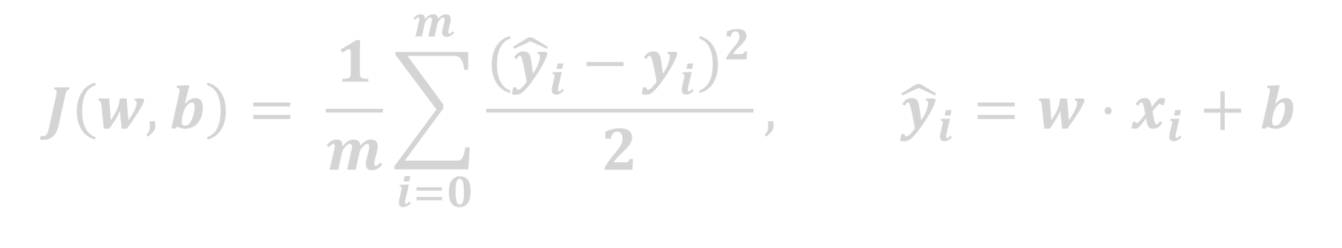
Gradient Descent
$$J\left(w, b\right)= \frac{1}{m}\sum_{i=0}^{m}{\frac{{\left({\hat{y}}_{i}−y_{i}\right)}^{2}}{2}}, {\hat{y}}_{i}=w⋅x_{i}+b$$

Slide 49
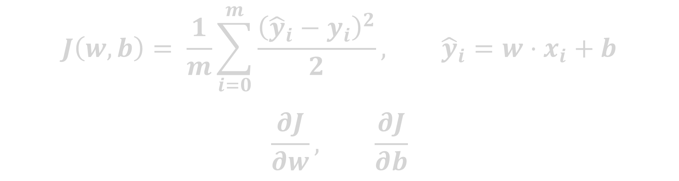
Gradient Descent
$$J\left(w, b\right)= \frac{1}{m}\sum_{i=0}^{m}{\frac{{\left({\hat{y}}_{i}−y_{i}\right)}^{2}}{2}}, {\hat{y}}_{i}=w⋅x_{i}+b$$
$$\frac{∂J}{∂w}, \frac{∂J}{∂b}$$

Slide 50
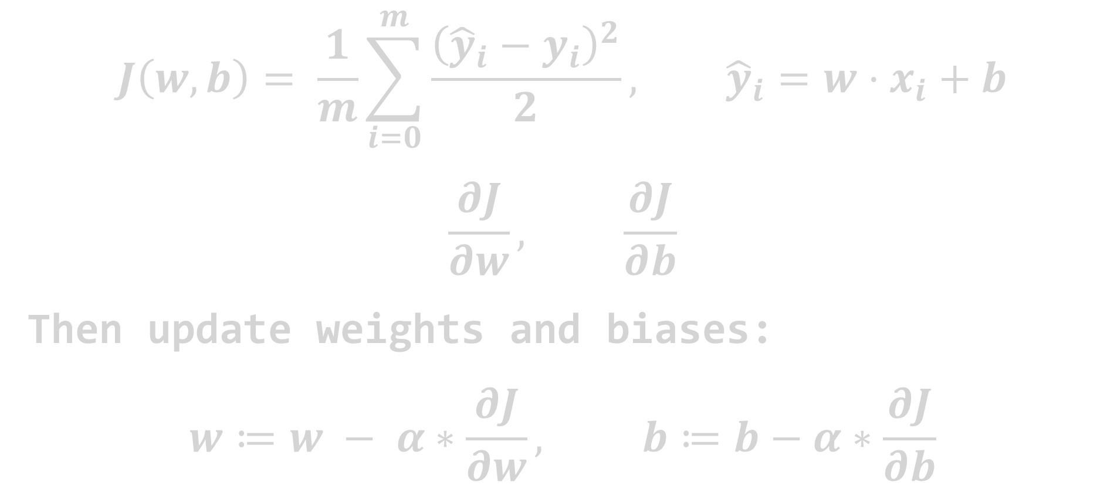
Gradient Descent
$$J\left(w, b\right)= \frac{1}{m}\sum_{i=0}^{m}{\frac{{\left({\hat{y}}_{i}−y_{i}\right)}^{2}}{2}}, {\hat{y}}_{i}=w⋅x_{i}+b$$
$$\frac{∂J}{∂w}, \frac{∂J}{∂b}$$
Then update weights and biases:
$$w≔w − α∗\frac{∂J}{∂w}, b≔b−α∗\frac{∂J}{∂b}$$

Slide 51
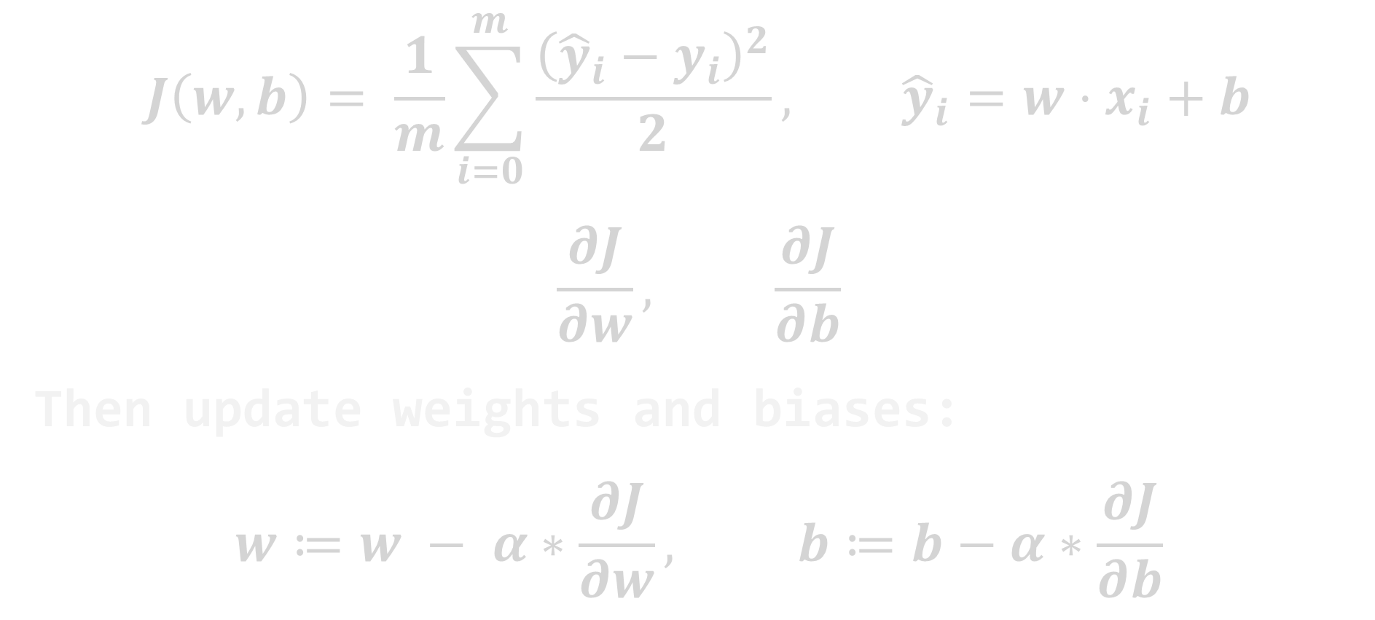
Gradient Descent
$$J\left(w, b\right)= \frac{1}{m}\sum_{i=0}^{m}{\frac{{\left({\hat{y}}_{i}−y_{i}\right)}^{2}}{2}}, {\hat{y}}_{i}=w⋅x_{i}+b$$
$$\frac{∂J}{∂w}, \frac{∂J}{∂b}$$
Then update weights and biases:
$$w≔w − α∗\frac{∂J}{∂w}, b≔b−α∗\frac{∂J}{∂b}$$
Learning rate

Slide 52
Gradient Descent
$$J\left(w, b\right)= \frac{1}{m}\sum_{i=0}^{m}{\frac{{\left({\hat{y}}_{i}−y_{i}\right)}^{2}}{2}}, {\hat{y}}_{i}=w⋅x_{i}+b$$
$$\frac{∂J}{∂w}, \frac{∂J}{∂b}$$
Then update weights and biases:
$$w≔w − α∗\frac{∂J}{∂w}, b≔b−α∗\frac{∂J}{∂b}$$

Slide 53

Gradient Descent
$$J\left(w, b\right)= \frac{1}{m}\sum_{i=0}^{m}{\frac{{\left({\hat{y}}_{i}−y_{i}\right)}^{2}}{2}}, {\hat{y}}_{i}=w⋅x_{i}+b$$
$$\frac{∂J}{∂w}=?$$

Slide 54

Gradient Descent
$$J\left(w, b\right)= \frac{1}{m}\sum_{i=0}^{m}{\frac{{\left({\hat{y}}_{i}−y_{i}\right)}^{2}}{2}}, {\hat{y}}_{i}=w⋅x_{i}+b$$
$$\frac{∂J}{∂w}=\frac{∂J}{∂{\hat{y}}_{i}}∗\frac{∂{\hat{y}}_{i}}{∂w}$$

Slide 55
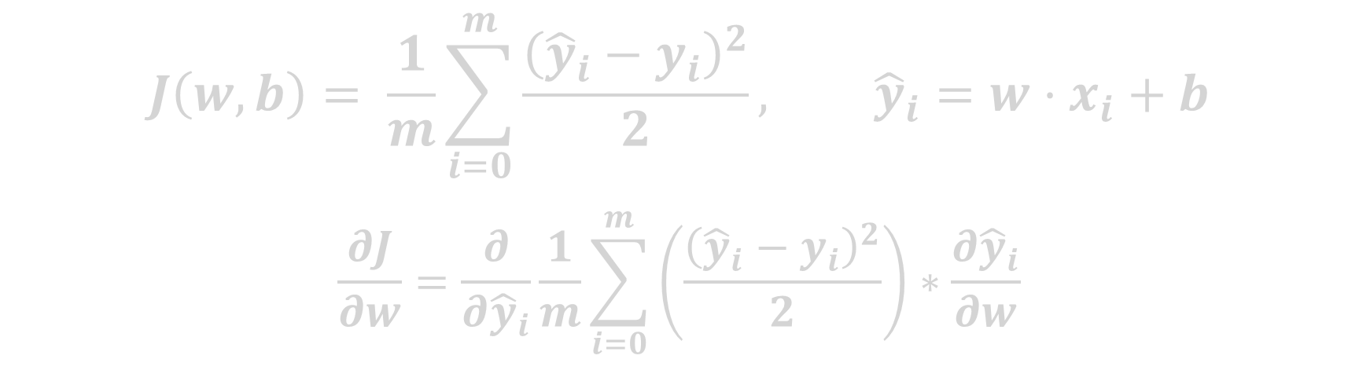
Gradient Descent
$$J\left(w, b\right)= \frac{1}{m}\sum_{i=0}^{m}{\frac{{\left({\hat{y}}_{i}−y_{i}\right)}^{2}}{2}}, {\hat{y}}_{i}=w⋅x_{i}+b$$
$$\frac{∂J}{∂w}=\frac{∂}{∂{\hat{y}}_{i}}\frac{1}{m}\sum_{i=0}^{m}{\left(\frac{{\left({\hat{y}}_{i}−y_{i}\right)}^{2}}{2}\right)}∗\frac{∂{\hat{y}}_{i}}{∂w}$$

Slide 56
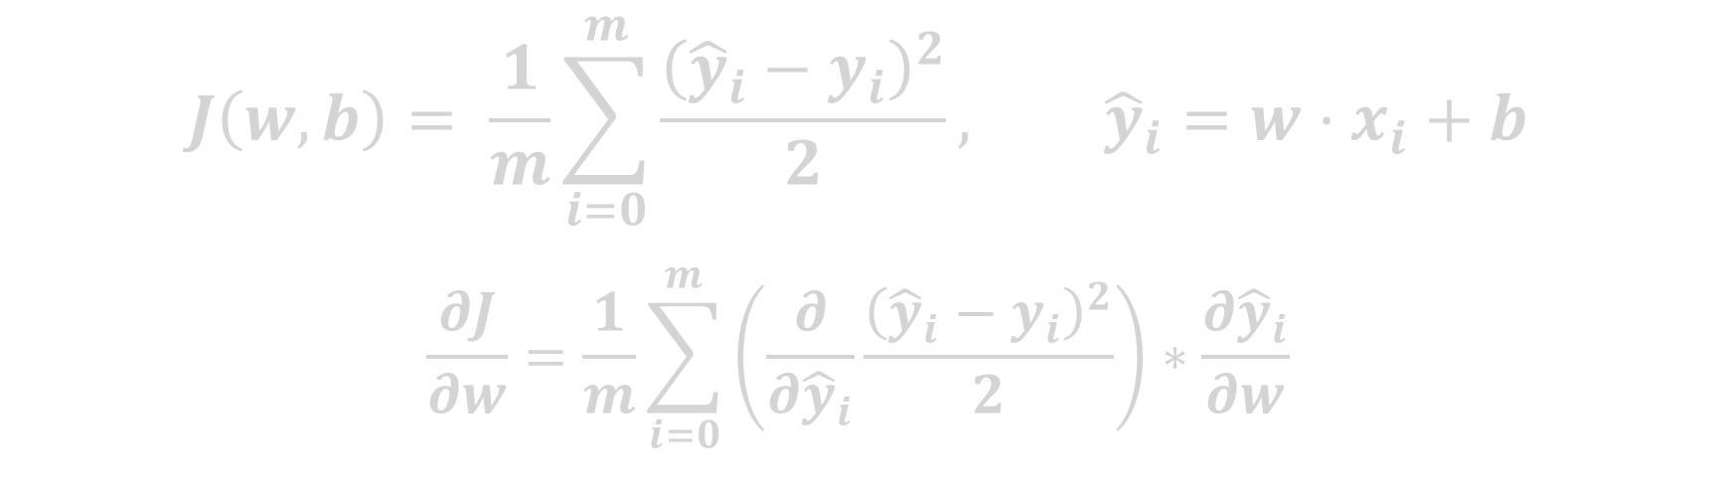
Gradient Descent
$$J\left(w, b\right)= \frac{1}{m}\sum_{i=0}^{m}{\frac{{\left({\hat{y}}_{i}−y_{i}\right)}^{2}}{2}}, {\hat{y}}_{i}=w⋅x_{i}+b$$
$$\frac{∂J}{∂w}=\frac{1}{m}\sum_{i=0}^{m}{\left(\frac{∂}{∂{\hat{y}}_{i}}\frac{{\left({\hat{y}}_{i}−y_{i}\right)}^{2}}{2}\right)}∗\frac{∂{\hat{y}}_{i}}{∂w}$$

Slide 57
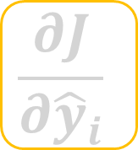
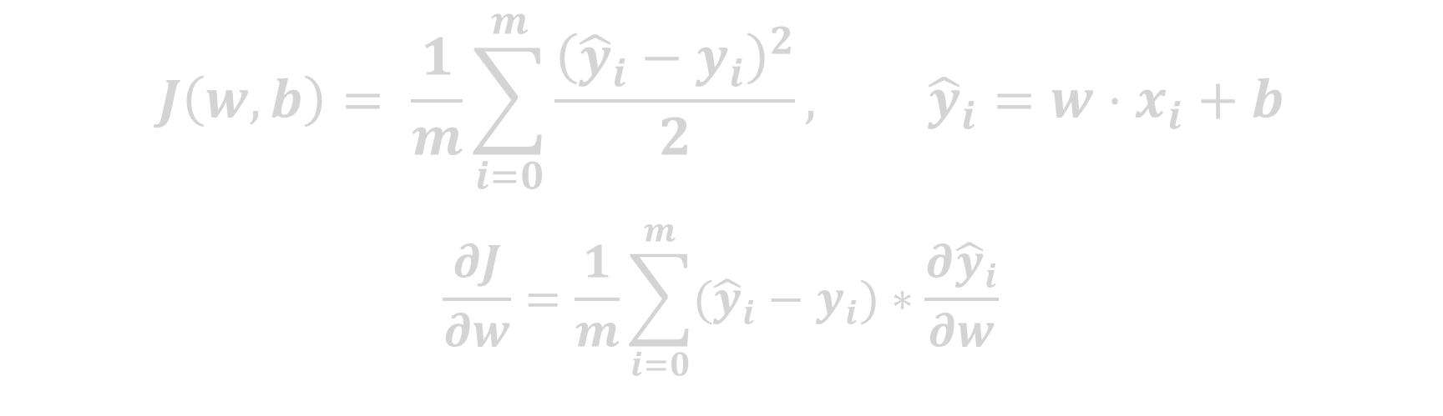
Gradient Descent
$$J\left(w, b\right)= \frac{1}{m}\sum_{i=0}^{m}{\frac{{\left({\hat{y}}_{i}−y_{i}\right)}^{2}}{2}}, {\hat{y}}_{i}=w⋅x_{i}+b$$
$$\frac{∂J}{∂w}=\frac{1}{m}\sum_{i=0}^{m}{({\hat{y}}_{i}−y_{i})}∗\frac{∂{\hat{y}}_{i}}{∂w}$$
$$\frac{∂J}{∂{\hat{y}}_{i}}$$

Slide 58
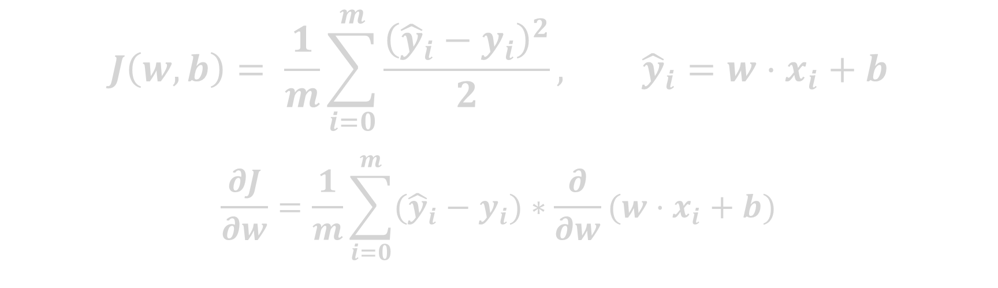
Gradient Descent
$$J\left(w, b\right)= \frac{1}{m}\sum_{i=0}^{m}{\frac{{\left({\hat{y}}_{i}−y_{i}\right)}^{2}}{2}}, {\hat{y}}_{i}=w⋅x_{i}+b$$
$$\frac{∂J}{∂w}=\frac{1}{m}\sum_{i=0}^{m}{({\hat{y}}_{i}−y_{i})}∗\frac{∂}{∂w}(w⋅x_{i}+b)$$

Slide 59
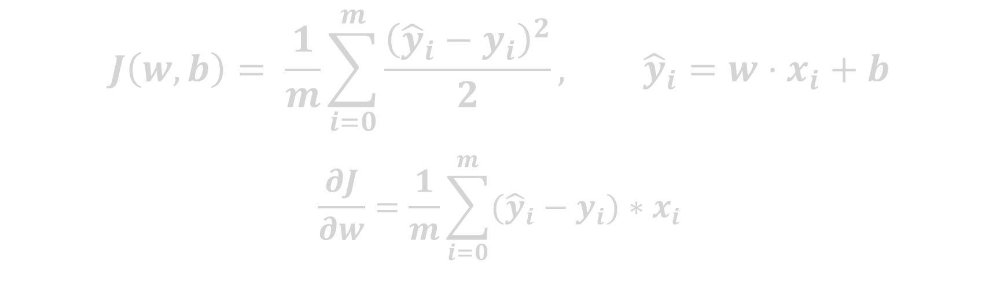
Gradient Descent
$$J\left(w, b\right)= \frac{1}{m}\sum_{i=0}^{m}{\frac{{\left({\hat{y}}_{i}−y_{i}\right)}^{2}}{2}}, {\hat{y}}_{i}=w⋅x_{i}+b$$
$$\frac{∂J}{∂w}=\frac{1}{m}\sum_{i=0}^{m}{({\hat{y}}_{i}−y_{i})}∗x_{i}$$

Slide 60

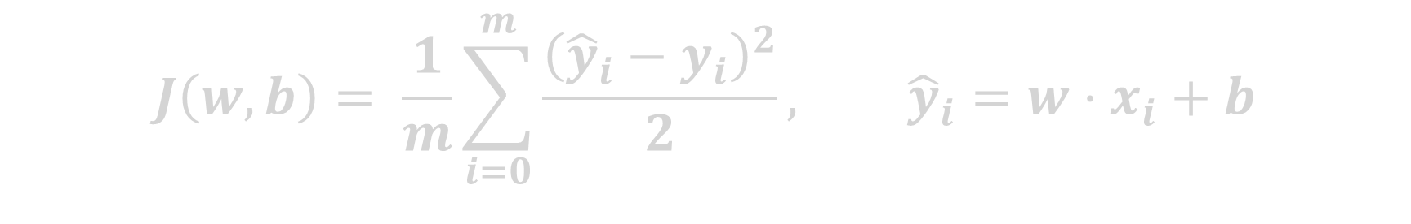
Gradient Descent
$$J\left(w, b\right)= \frac{1}{m}\sum_{i=0}^{m}{\frac{{\left({\hat{y}}_{i}−y_{i}\right)}^{2}}{2}}, {\hat{y}}_{i}=w⋅x_{i}+b$$
$$\frac{∂J}{∂w}=\frac{1}{m}\sum_{i=0}^{m}{({\hat{y}}_{i}−y_{i})}∗x_{i}$$

Slide 61
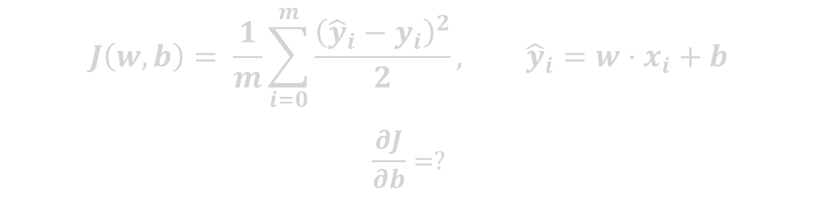
Gradient Descent
$$J\left(w, b\right)= \frac{1}{m}\sum_{i=0}^{m}{\frac{{\left({\hat{y}}_{i}−y_{i}\right)}^{2}}{2}}, {\hat{y}}_{i}=w⋅x_{i}+b$$
$$\frac{∂J}{∂b}=?$$
$$\frac{∂J}{∂w}=\frac{1}{m}\sum_{i=0}^{m}{({\hat{y}}_{i}−y_{i})}∗x_{i}$$

Slide 62
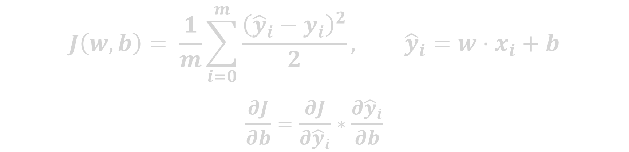
Gradient Descent
$$J\left(w, b\right)= \frac{1}{m}\sum_{i=0}^{m}{\frac{{\left({\hat{y}}_{i}−y_{i}\right)}^{2}}{2}}, {\hat{y}}_{i}=w⋅x_{i}+b$$
$$\frac{∂J}{∂b}=\frac{∂J}{∂{\hat{y}}_{i}}∗\frac{∂{\hat{y}}_{i}}{∂b}$$
$$\frac{∂J}{∂w}=\frac{1}{m}\sum_{i=0}^{m}{({\hat{y}}_{i}−y_{i})}∗x_{i}$$

Slide 63
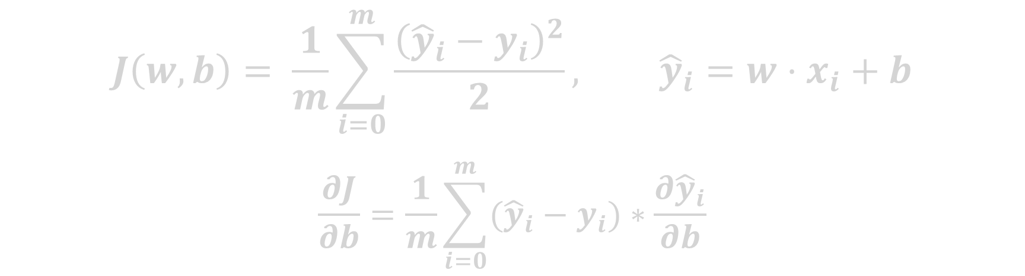
Gradient Descent
$$J\left(w, b\right)= \frac{1}{m}\sum_{i=0}^{m}{\frac{{\left({\hat{y}}_{i}−y_{i}\right)}^{2}}{2}}, {\hat{y}}_{i}=w⋅x_{i}+b$$
$$\frac{∂J}{∂b}=\frac{1}{m}\sum_{i=0}^{m}{({\hat{y}}_{i}−y_{i})}∗\frac{∂{\hat{y}}_{i}}{∂b}$$
$$\frac{∂J}{∂w}=\frac{1}{m}\sum_{i=0}^{m}{({\hat{y}}_{i}−y_{i})}∗x_{i}$$

Slide 64
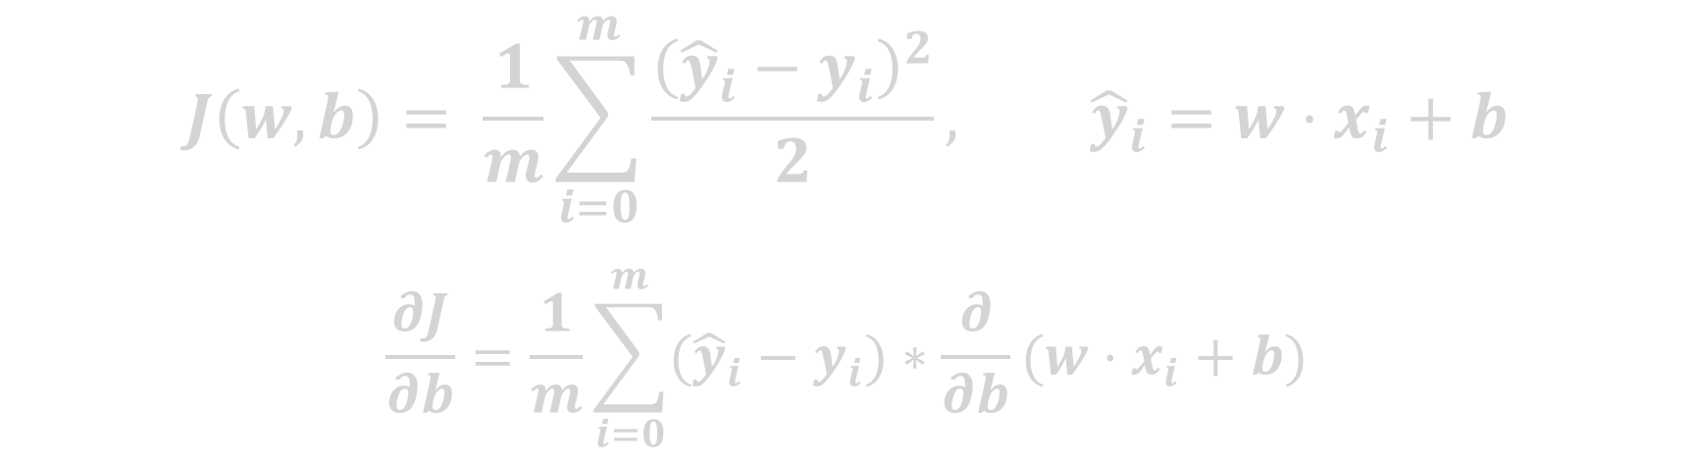
Gradient Descent
$$J\left(w, b\right)= \frac{1}{m}\sum_{i=0}^{m}{\frac{{\left({\hat{y}}_{i}−y_{i}\right)}^{2}}{2}}, {\hat{y}}_{i}=w⋅x_{i}+b$$
$$\frac{∂J}{∂b}=\frac{1}{m}\sum_{i=0}^{m}{({\hat{y}}_{i}−y_{i})}∗\frac{∂}{∂b}(w⋅x_{i}+b)$$
$$\frac{∂J}{∂w}=\frac{1}{m}\sum_{i=0}^{m}{({\hat{y}}_{i}−y_{i})}∗x_{i}$$

Slide 65
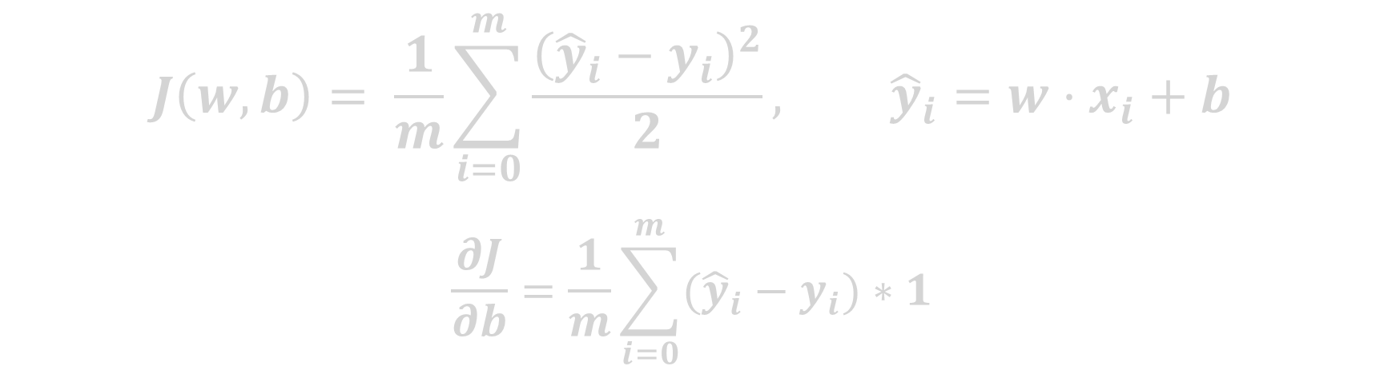
Gradient Descent
$$J\left(w, b\right)= \frac{1}{m}\sum_{i=0}^{m}{\frac{{\left({\hat{y}}_{i}−y_{i}\right)}^{2}}{2}}, {\hat{y}}_{i}=w⋅x_{i}+b$$
$$\frac{∂J}{∂b}=\frac{1}{m}\sum_{i=0}^{m}{({\hat{y}}_{i}−y_{i})}∗1$$
$$\frac{∂J}{∂w}=\frac{1}{m}\sum_{i=0}^{m}{({\hat{y}}_{i}−y_{i})}∗x_{i}$$

Slide 66
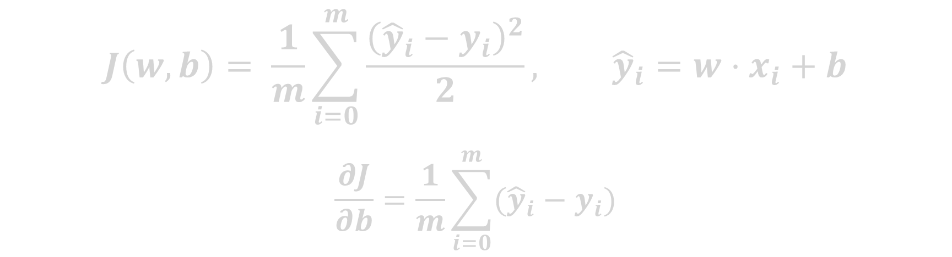
Gradient Descent
$$J\left(w, b\right)= \frac{1}{m}\sum_{i=0}^{m}{\frac{{\left({\hat{y}}_{i}−y_{i}\right)}^{2}}{2}}, {\hat{y}}_{i}=w⋅x_{i}+b$$
$$\frac{∂J}{∂b}=\frac{1}{m}\sum_{i=0}^{m}{({\hat{y}}_{i}−y_{i})}$$
$$\frac{∂J}{∂w}=\frac{1}{m}\sum_{i=0}^{m}{({\hat{y}}_{i}−y_{i})}∗x_{i}$$

Slide 67
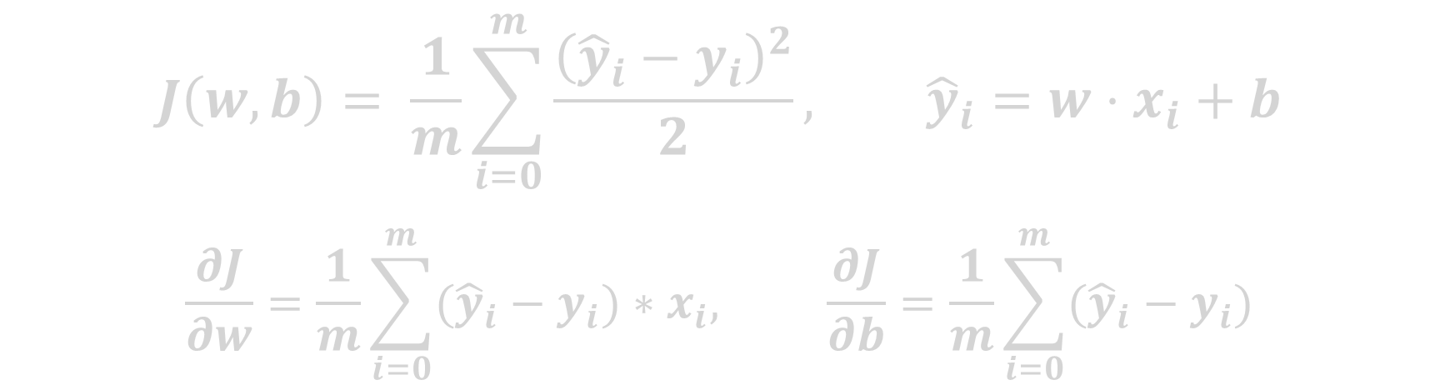
Gradient Descent
$$J\left(w, b\right)= \frac{1}{m}\sum_{i=0}^{m}{\frac{{\left({\hat{y}}_{i}−y_{i}\right)}^{2}}{2}}, {\hat{y}}_{i}=w⋅x_{i}+b$$
$$\frac{∂J}{∂w}=\frac{1}{m}\sum_{i=0}^{m}{({\hat{y}}_{i}−y_{i})}∗x_{i}, \frac{∂J}{∂b}=\frac{1}{m}\sum_{i=0}^{m}{({\hat{y}}_{i}−y_{i})}$$

Slide 68
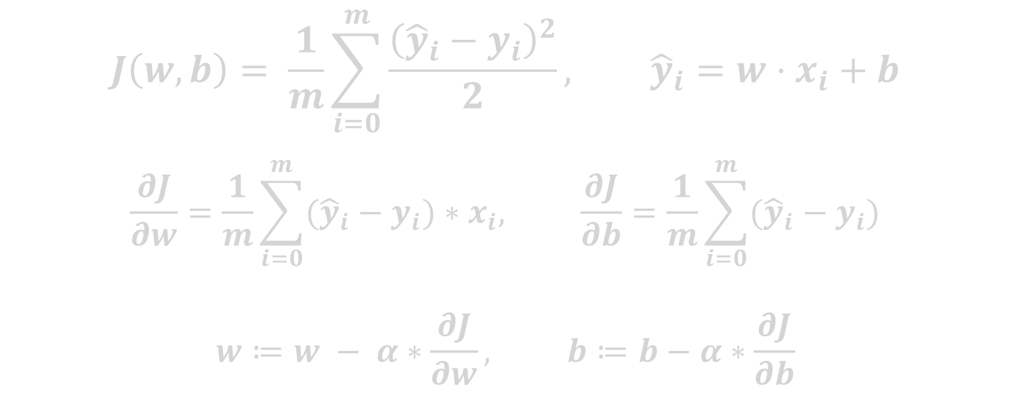
Gradient Descent
$$J\left(w, b\right)= \frac{1}{m}\sum_{i=0}^{m}{\frac{{\left({\hat{y}}_{i}−y_{i}\right)}^{2}}{2}}, {\hat{y}}_{i}=w⋅x_{i}+b$$
$$\frac{∂J}{∂w}=\frac{1}{m}\sum_{i=0}^{m}{({\hat{y}}_{i}−y_{i})}∗x_{i}, \frac{∂J}{∂b}=\frac{1}{m}\sum_{i=0}^{m}{({\hat{y}}_{i}−y_{i})}$$
$$w≔w − α∗\frac{∂J}{∂w}, b≔b−α∗\frac{∂J}{∂b}$$

Slide 69
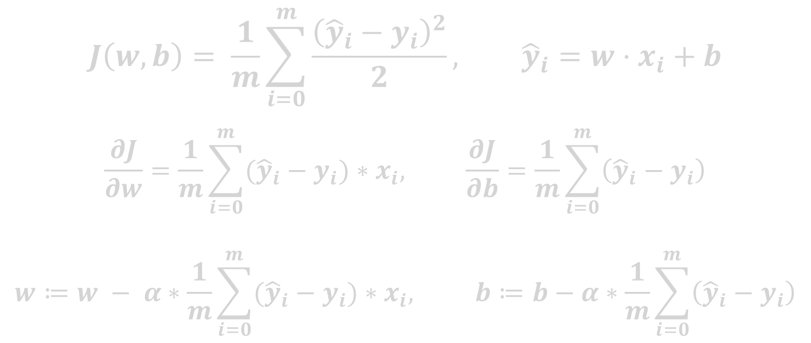
Gradient Descent
$$J\left(w, b\right)= \frac{1}{m}\sum_{i=0}^{m}{\frac{{\left({\hat{y}}_{i}−y_{i}\right)}^{2}}{2}}, {\hat{y}}_{i}=w⋅x_{i}+b$$
$$\frac{∂J}{∂w}=\frac{1}{m}\sum_{i=0}^{m}{({\hat{y}}_{i}−y_{i})}∗x_{i}, \frac{∂J}{∂b}=\frac{1}{m}\sum_{i=0}^{m}{\left({\hat{y}}_{i}−y_{i}\right)}$$
$$w≔w − α∗\frac{1}{m}\sum_{i=0}^{m}{({\hat{y}}_{i}−y_{i})}∗x_{i}, b≔b−α∗\frac{1}{m}\sum_{i=0}^{m}{\left({\hat{y}}_{i}−y_{i}\right)}$$

Slide 70
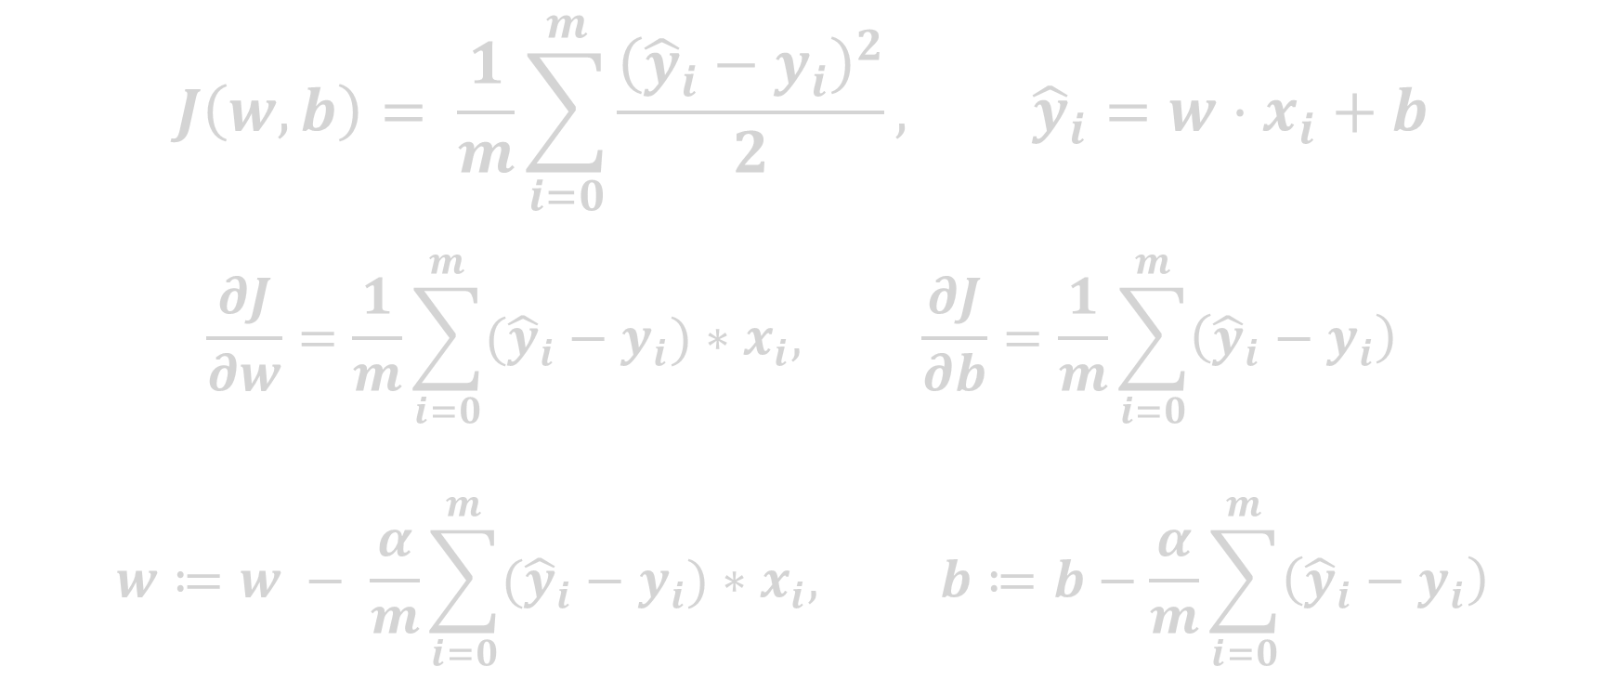
Gradient Descent
$$J\left(w, b\right)= \frac{1}{m}\sum_{i=0}^{m}{\frac{{\left({\hat{y}}_{i}−y_{i}\right)}^{2}}{2}}, {\hat{y}}_{i}=w⋅x_{i}+b$$
$$\frac{∂J}{∂w}=\frac{1}{m}\sum_{i=0}^{m}{({\hat{y}}_{i}−y_{i})}∗x_{i}, \frac{∂J}{∂b}=\frac{1}{m}\sum_{i=0}^{m}{\left({\hat{y}}_{i}−y_{i}\right)}$$
$$w≔w − \frac{α}{m}\sum_{i=0}^{m}{({\hat{y}}_{i}−y_{i})}∗x_{i}, b≔b−\frac{α}{m}\sum_{i=0}^{m}{\left({\hat{y}}_{i}−y_{i}\right)}$$

Slide 71
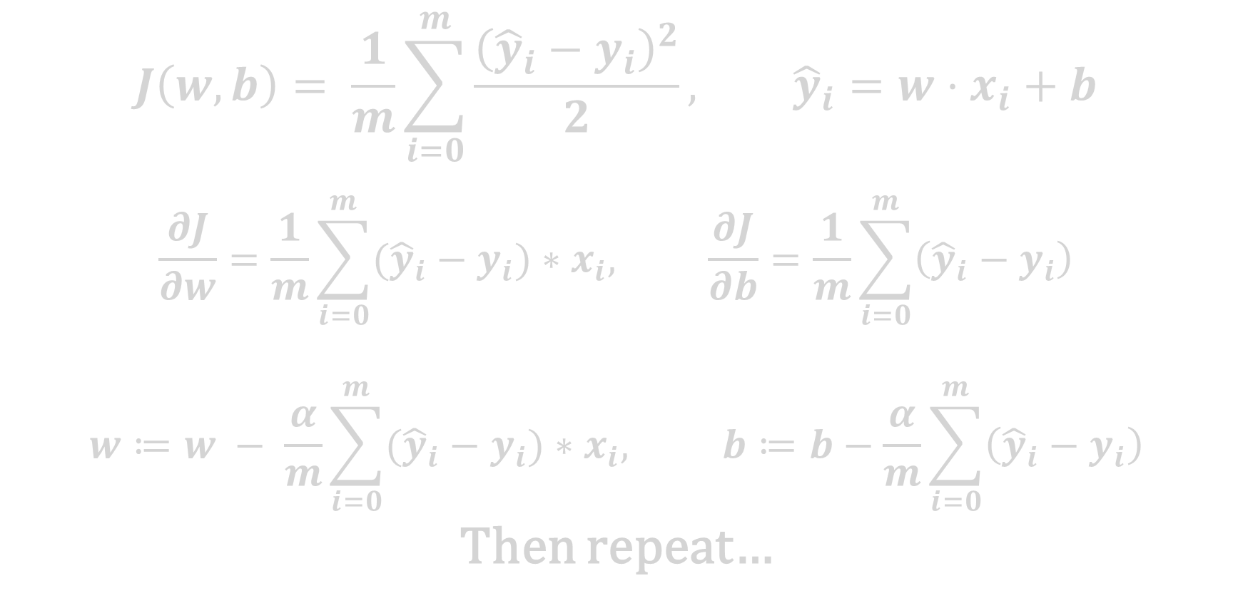
Gradient Descent
$$J\left(w, b\right)= \frac{1}{m}\sum_{i=0}^{m}{\frac{{\left({\hat{y}}_{i}−y_{i}\right)}^{2}}{2}}, {\hat{y}}_{i}=w⋅x_{i}+b$$
$$\frac{∂J}{∂w}=\frac{1}{m}\sum_{i=0}^{m}{({\hat{y}}_{i}−y_{i})}∗x_{i}, \frac{∂J}{∂b}=\frac{1}{m}\sum_{i=0}^{m}{\left({\hat{y}}_{i}−y_{i}\right)}$$
$$w≔w − \frac{α}{m}\sum_{i=0}^{m}{({\hat{y}}_{i}−y_{i})}∗x_{i}, b≔b−\frac{α}{m}\sum_{i=0}^{m}{\left({\hat{y}}_{i}−y_{i}\right)}$$
Then repeat…

Slide 72
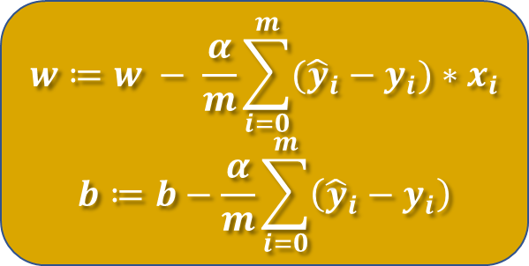
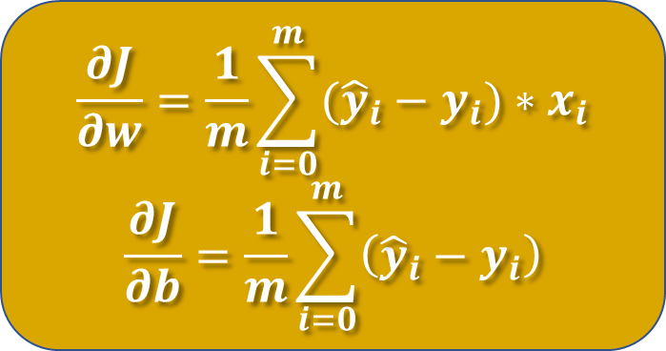
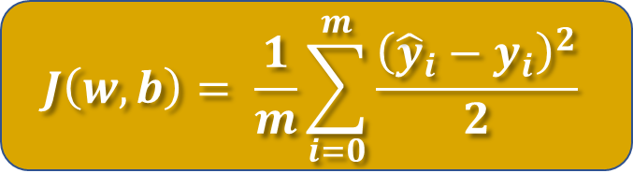
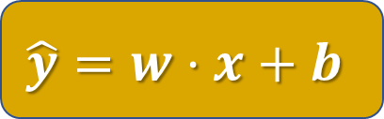

Gradient Descent
$$J\left(w, b\right)= \frac{1}{m}\sum_{i=0}^{m}{\frac{{\left({\hat{y}}_{i}−y_{i}\right)}^{2}}{2}}$$
$$x, y$$
$$\hat{y}=w⋅x+b$$
$$\frac{∂J}{∂w}=\frac{1}{m}\sum_{i=0}^{m}{({\hat{y}}_{i}−y_{i})}∗x_{i}$$
$$\frac{∂J}{∂b}=\frac{1}{m}\sum_{i=0}^{m}{\left({\hat{y}}_{i}−y_{i}\right)}$$
$$w≔w − \frac{α}{m}\sum_{i=0}^{m}{({\hat{y}}_{i}−y_{i})}∗x_{i}$$
$$b≔b−\frac{α}{m}\sum_{i=0}^{m}{\left({\hat{y}}_{i}−y_{i}\right)}$$

Slide 73
Gradient Descent
Advantages and Disadvantages

Slide 74
Gradient Descent
Advantages:
Can be used to optimize any differentiable cost function.
Relatively easy to implement and understand.
Can be used for both linear and nonlinear models.
Disadvantages:
Requires choosing an appropriate learning rate.
Can get stuck in local minima.
May require a large number of iterations to converge.

Slide 75
Normalization & Standardization

Slide 76
Normalization
Normalization is the process of scaling the data so that it falls within a specific range, this technique is useful when the range of values in the data varies widely, and the range of values for different features is not known.
Normalization is beneficial when dealing with algorithms that assume a Gaussian distribution in the input data, such as neural networks, linear regression, and logistic regression.
Normalization can also help speed up training and improve the performance of the model.

Slide 77
Normalization
Normalization is the process of scaling the data so that it falls within a specific range, this technique is useful when the range of values in the data varies widely, and the range of values for different features is not known.
Normalization is beneficial when dealing with algorithms that assume a Gaussian distribution in the input data, such as neural networks, linear regression, and logistic regression.
Normalization can also help speed up training and improve the performance of the model.

Slide 78
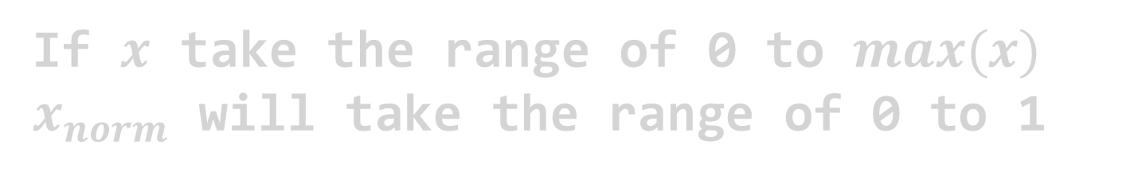
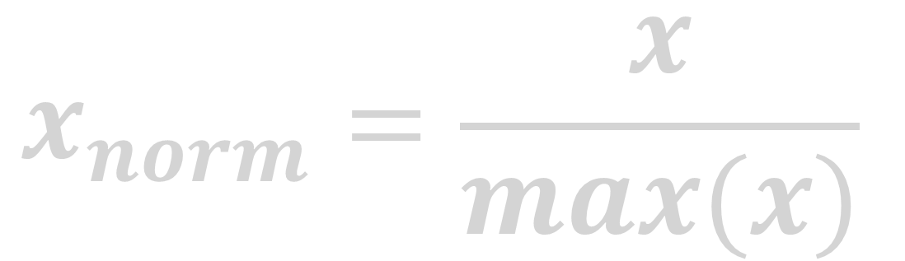
Normalization
$$x_{norm}=\frac{x}{max(x)}$$
If $x$ take the range of 0 to $max(x)⁡$
$x_{norm}$ will take the range of 0 to 1

Slide 79

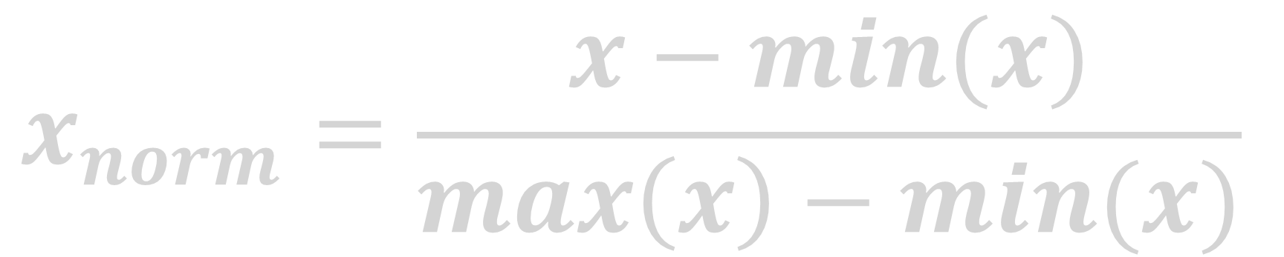
Normalization
$$x_{norm}=\frac{x−min(x)}{max\left(x\right)−min(x)}$$
$x_{norm}$ will take the range of 0 to 1

Slide 80
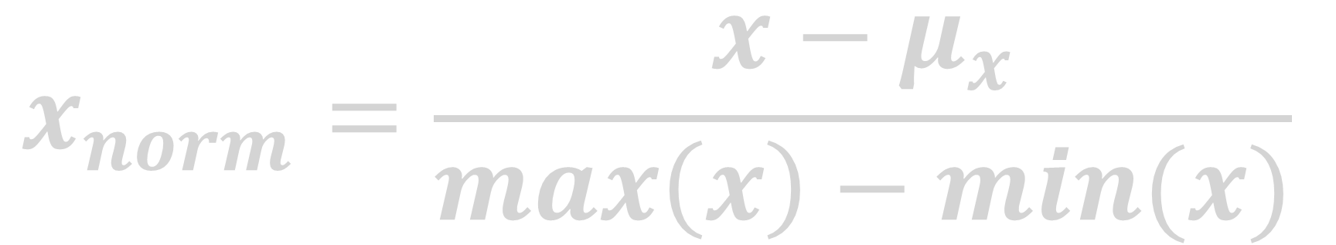
Normalization
$$x_{norm}=\frac{x−μ_{x}}{max\left(x\right)−min(x)}$$
$x_{norm}$ will take the range of -1 to 1

Slide 81
Standardization
Standardization is the process of scaling the data so that it has a mean of zero and a standard deviation of one. Unlike normalization, standardization does not force the data to fall within a specific range. Instead, it transforms the data to have a specific distribution.
This technique is useful when the data has a Gaussian distribution and the range of values for different features is known. a
Standardization is beneficial when dealing with algorithms that do not assume a specific distribution in the input data, such as support vector machines, k-nearest neighbors, and decision trees.

Slide 82

Standardization
$$x_{norm}=\frac{x−μ_{x}}{σ_{x}}$$
$x_{norm}$ will have mean of 0 and standard deviation of 1

Slide 83
Differences
The main difference between normalization and standardization is the scale of the resulting data.
Normalization scales the data to fall between 0 and 1, while standardization scales the data so that it has a mean of zero and a standard deviation of one.
Normalization is useful when the range of values for different features is not known, while standardization is useful when the range of values for different features is known. Normalization can be beneficial when dealing with algorithms that assume a Gaussian distribution, while standardization can be beneficial when dealing with algorithms that do not assume a specific distribution.

Slide 84
Use Cases
Normalization is useful when dealing with algorithms that assume a Gaussian distribution, such as neural networks, linear regression, and logistic regression.
Standardization is useful when dealing with algorithms that do not assume a specific distribution, such as support vector machines (SVM), k-nearest neighbors (KNN), and decision trees.
The choice between normalization and standardization ultimately depends on the nature of the data and the algorithm being used.

Slide 85
Wrapping up

Slide 86
Regression Models
Model: A computer program is said to learn from experience (E) with respect to some class of tasks (T) and performance measure (P) if its performance at tasks in (T), as measured by (P), improves with experience (E). (Tom Mitchel)

Slide 87
Wrapping up
Machine learning vs traditional programming
Types of machine learning
Supervised
Unsupervised
Reinforcement
Linear regression
Cost function (mean squared error)
Gradient descent
Learning rate
Normalization
Standardization
Thank you for sticking with me

Slide 88


